Slide 1

Current Status of Global Rare Earth Resources Development and Utilization & Reflections on the High-Quality Development of China's Rare Earth Resources During the 15th Five-Year Plan Period
我们的使命
Ruijun Li
Chinese Academy of Natural Resources Economics
15.05.2026 Xiamen

Slide 2
1. Current Status of Global Rare Earth Development and Utilization
2. Development Policies for Rare Earth and Other Critical Minerals in the US and Europe
3. Global Trends in Rare Earth Development
4. Current Status and Development Trends of China’s Rare Earth Industry During the 15th Five-Year Plan Period
5. Proposals for the High-Quality Development of China’s Rare Earth Industry During the 15th Five-Year Plan Period
Content

Slide 3

1. Current Status of Global Rare Earth Development and Utilization

Slide 4
Global Rare Earth Resource Status
Global Rare Earth Reserves (10,000 t)
Country | 2019 | 2021 | 2023 | 2025e
U.S. | 140 | 180 | 180 | 180
Australia | 330 | 400 | 570 | 570
Brazil | 2,200 | 2,100 | 2,100 | 2,100
Canada | 83 | 83 | 83 | 83
China | 4,400 | 4,400 | 4,400 | 4,400
Greenland | 150 | 150 | 150 | 150
India | 690 | 690 | 690 | 690
Russia | 1,200 | 2,100 | 1,000 | 1,000
South Africa | 79 | 79 | 79 | 79
Tanzania | 89 | 89 | 89 | 89
Vietnam | 2,200 | 2,200 | 2,200 | 2,200
Other | 439 | 28 | 0.45 | 0.45
Total | 12,000 | 12,499 | 11,541 | 11,541
Global rare earth resources are highly concentrated
Global rare earth resources are highly concentrated, with nearly 95% of reserves held by the top six countries. China accounts for 38.12% of the total, representing the largest share.

Slide 5
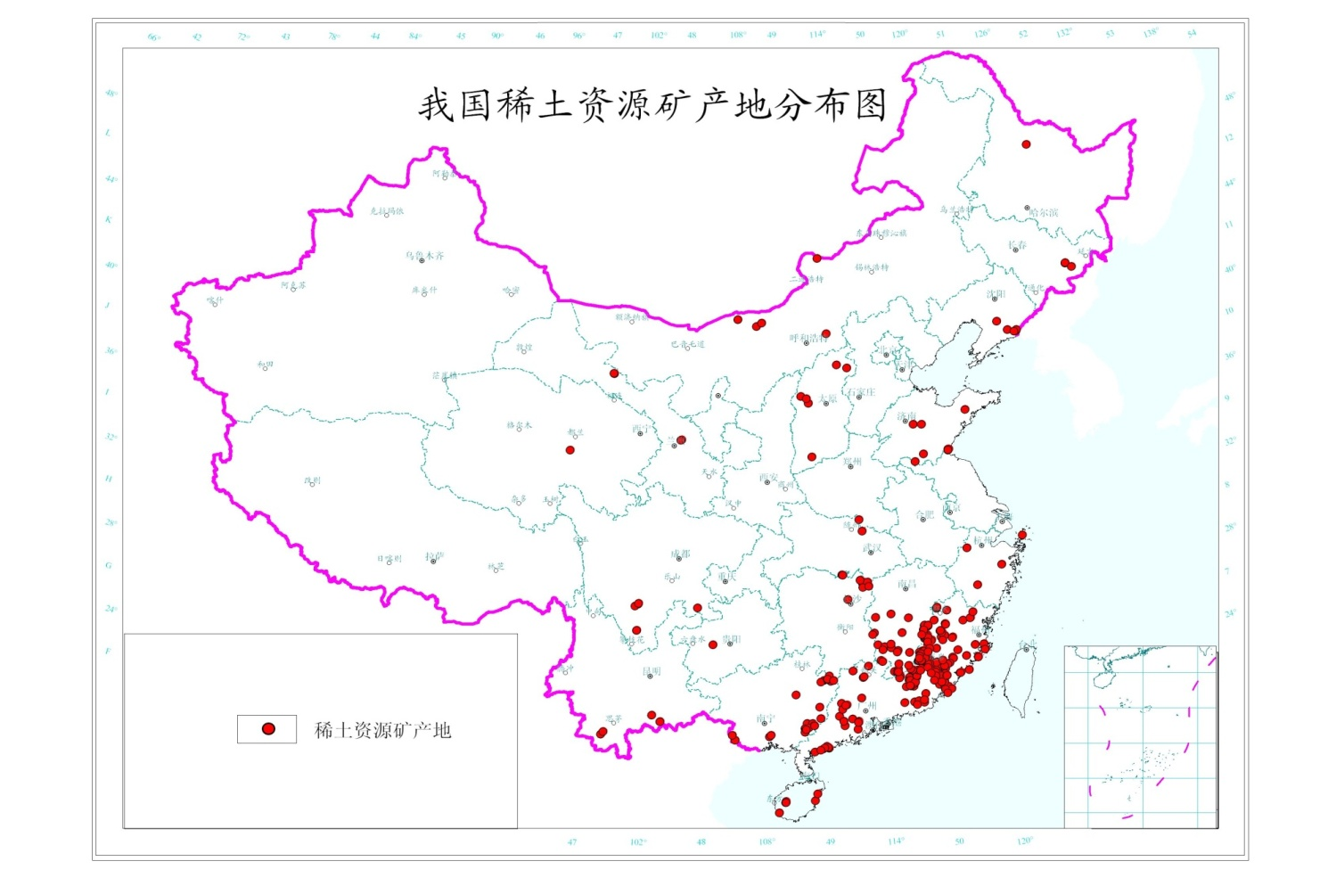
China’s Rare Earth Resource Advantages
China has globally leading rare earth reserves, particularly abundant in heavy rare earth resources. However, development is constrained, leading to supply shortages.
Distribution Map of Rare Earth Resource Mining Areas in China
Bayan Obo, Baotou, Inner Mongolia
Weishan Lake, Jining, Shandong
Liangshan Prefecture, Sichuan
---------------
Nanling Region
Rare Earth Resource Mining Areas

Slide 6
Global Rare Earth Production Is Highly Concentrated
Over 95% of the world’s rare earth smelting and separation capacity is concentrated in China.
In 2025, global rare earth mine production reached 402,000 tonnes, with China accounting for 270,000 tonnes or 67.5% of the total. The United States and Myanmar saw particularly notable increases in output.
Over 95% of the world’s rare earth smelting and separation capacity is concentrated in China. However, capacity growth is emerging in Australia, the United States, and Estonia.
Rare Earth Mineral Production by Major Countries (tonnes, REO)
Country | 2021 | 2023 | 2025e
China | 210,000 | 255,000 | 270,000
U.S. | 42,000 | 43,000 | 45,000
Australia | 18,000 | 18,000 | 21,000
Brazil | 80 | 80 | 500
India | 2,900 | 2,900 | 2,900
Malaysia | 80 | 80 | 200
Russia | 2,600 | 2,600 | 2,600
Thailand | 7,100 | 7,100 | 7,300
Vietnam | 1,200 | 600 | 5,000
Madagascar | 960 | 960 | 960
Burundi | 0 | 0 | 0
Myanmar (1) | 12,000 | 38,000 | 46,500
Other | 0 | 0 | 0
Total | 296,920 | 368,320 | 401,960
China’s Share | 70.7% | 69.2% | 67.2%
Major Countries’ Rare Earth Smelting Output and Forecast (tonnes, REO)
Country | 2021 | 2023 | 2025e
China | 288,149 | 369,391 | 380,568
Malaysia | 16,552 | 13,960 | 11,273
U.S. | - | 1,300 | 7,831
Other | 2,150 | 2,150 | 2,500
Total | 306,851 | 386,801 | 402,172
YOY (%) | 13% | 26% | 4%
China’s Share (%) | 94% | 95% | 95%

Slide 7
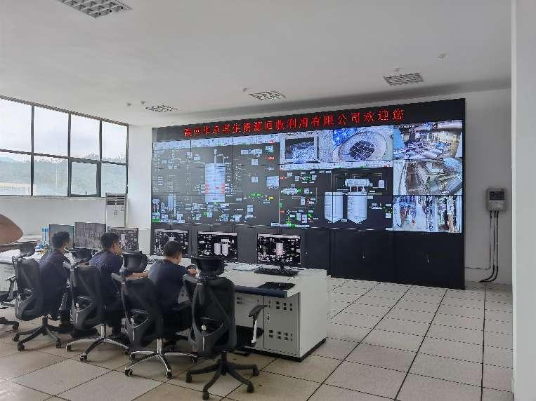
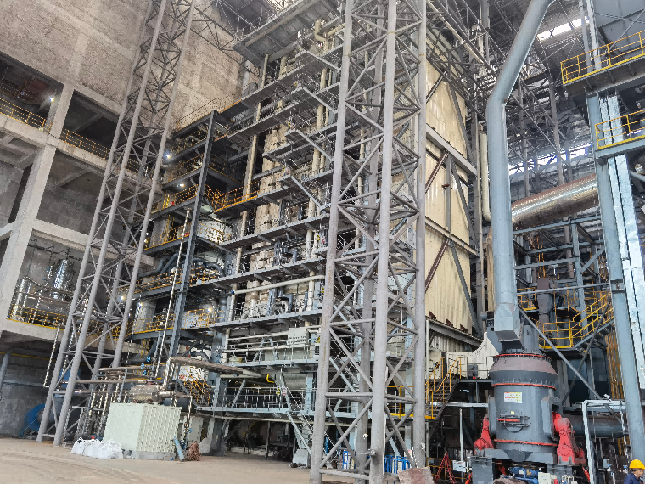
Recovery and Utilization of Monazite and NdFeB Magnet Scrap
Domestic Rare Earth Capacity Concentration Intensifies
The processing of monazite and the recovery of NdFeB magnet scrap have become important pathways to fill the supply gap in rare earth.
China implements a quota system for rare earth mining and smelting. In 2024, the quotas increased by 6% and 4% year-on-year, respectively, leading to a further rise in industry concentration. This has resulted in the formation of two major rare earth groups.
Rare Earth Mining and Smelting Separation Quotas (2022-2024)
Enterprise | Mining Quota (tonnes) |  |  | Smelting & Separation Quota (tonnes)
 | 2022 | 2023 | 2024 | 2022 | 2023 | 2024
China Total | 210,000 | 255,000 | 270,000 | 202,000 | 243,850 | 254,000
1. Northern Rare Earth | 141,650 | 178,650 | 188,650 | 128,934 | 163,234 | 170,001
2. China Rare Earth Group | 62,210 | 70,210 | 81,350 | 58,499 | 66,049 | 83,999
3. Xiamen Tungsten | 3,440 | 3,440 |  | 3,963 | 3,963
4. Guangdong Rare Earth | 2,700 | 2,700 |  | 10,604 | 10,604
XXX Renewable Resources Recycling Co., Ltd. produces 68,000 tonnes of mixed rare earth oxide raw materials annually (equivalent to approximately 17,000 tonnes of rare earth oxides), accounting for 45% of the nation's total recycling capacity (150,000 tonnes per year).

Slide 8
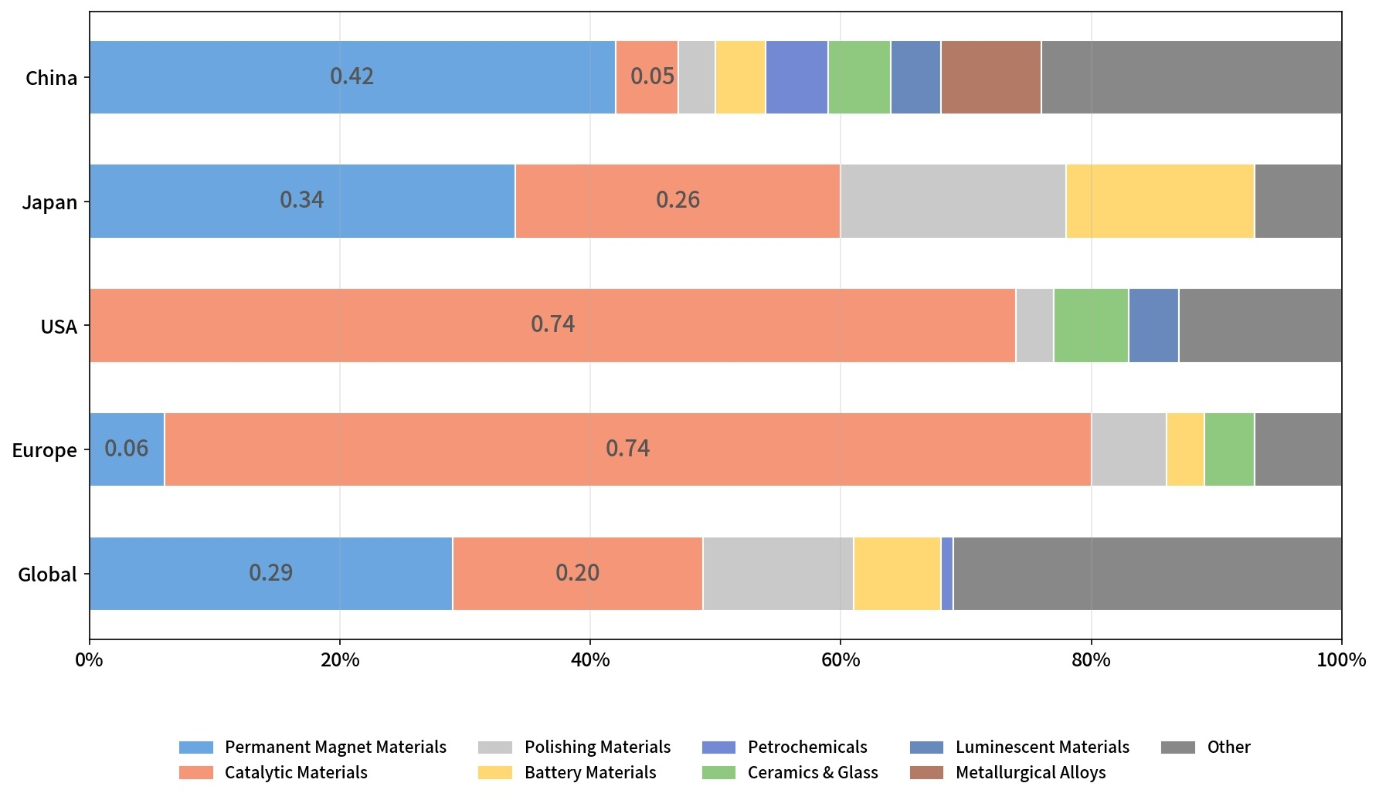
Global Rare Earth Consumption Structure and Consumption by Major Countries/Regions
China Accounts for 89% of Global Rare Earth Consumption
In 2025, global consumption of rare earth oxides grew by 6.3%, with China accounting for 89.2% of the total. It is projected that China's share would reach 90.5% in 2025.
China
Japan
U.S.
Total
Rare Earth Permanent Magnet Materials Account for 29% of Consumption
In global rare earth consumption, permanent magnet materials account for 29%, ranking first among all application sectors.
Magnet
Catalyst
Polishing
Battery
Petrochemical
Ceramic& Glass
Phosphor
Alloy
Other

Slide 9
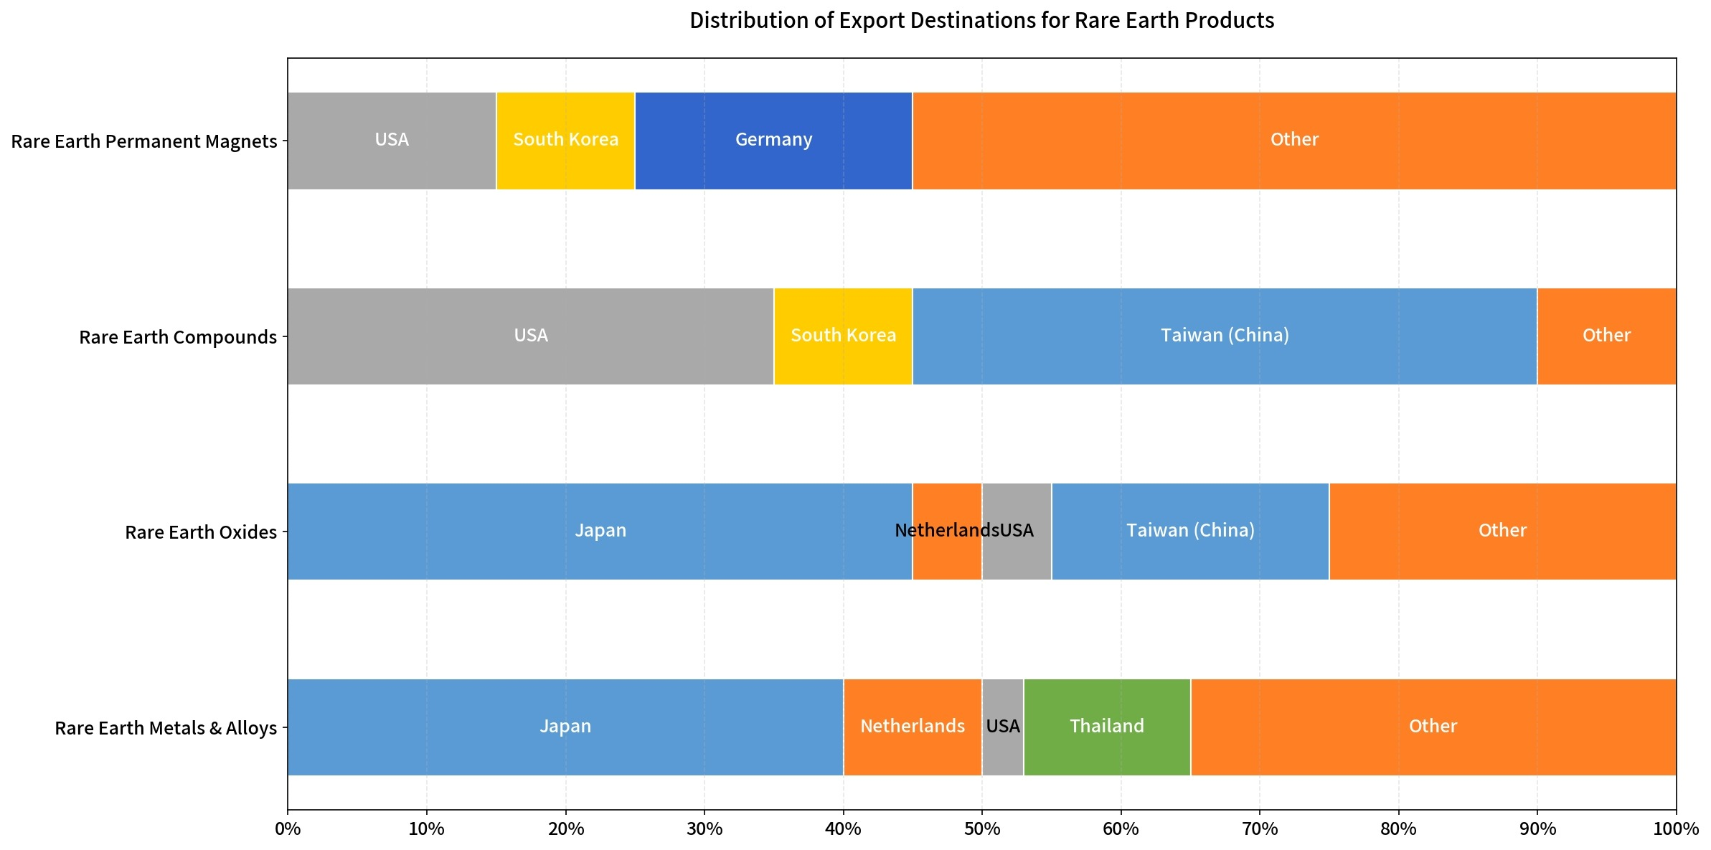
Characteristics of China's Rare Earth Trade
Over 50% of Rare Earth Imports in the US, Europe, Japan, and South Korea Come from China
China is the world’s largest rare earth trading nation. Its exports are dominated by deep-processed materials, while its imports focus on primary raw materials, mainly sourced from the United States and Myanmar.
China's rare earth exports are primarily concentrated in the US, Europe, Japan, and South Korea, accounting for more than 50% of the total. Export products include rare earth permanent magnets, compounds, oxides, metals, and alloys.
Import and Export Statistics of China's Rare Earth Products in 2025
Product | Import | Export | Net Import
Concentrates | 55,712 | 0 | 55,712
Smelting Products | 106,141 | 18,738 | 87,403
Metals & Alloys | 345.6 | 8,895 | -8,549.4
Oxides | 49,620 | 23,214 | 26,406
Salts | 27,255 | 23,254 | 4,001
Permanent Magnets | 2,018 | 58,152 | -56,134
Total (Physical Volume) | 241,091.6 | 132,253 | 108,838.6
Share of China's Rare Earth Product Exports by Destination in 2025

Slide 10
2. Development Policies for Rare Earth and Other Critical Minerals in the US and Europe

Slide 11
U.S. Critical Minerals Strategy
Box 2-1: Six Key Tasks of the Federal Strategy to Ensure Secure and Reliable Supplies of Critical Minerals
1. Advance transformational R&D and deployment for critical minerals supply chain Develop an R&D strategy to enhance technological capabilities across the critical minerals supply chain Increase private-sector investment in innovation and improve federally funded science and technology transfer Coordinate diversification of resource sources, improve utilization efficiency, and encourage substitution and recycling of critical minerals Expand secondary and unconventional sources of critical minerals 2. Strengthen the critical minerals supply chain and defense industrial base Enhance and optimize U.S. downstream material production capacity and supply chain resilience Reinforce the National Defense Stockpile’s ability to respond rapidly to emergency and unanticipated military and essential civilian needs during wartime or other national emergencies 3. Strengthen international trade and cooperation Enhance international exchanges with partner countries Expand trade and investment with international partners to securely access critical minerals 4. Improve domestic critical mineral resource research Develop indicators for critical mineral supply and consumption Conduct critical mineral resource assessments and encourage secondary resource utilization Improve geophysical, geological, topographic, and bathymetric mapping of coastal and maritime territories Enhance the utilization efficiency of geophysical, geological, topographic, and bathymetric data 5. Optimize access to critical mineral resources and approval timelines Revise land use planning procedures to improve access to critical mineral resources Review legal provisions that restrict critical mineral exploration and development Assess the impact of federal land management plans and existing infrastructure on mineral exploration and development Implement optimized critical mineral regulations to ensure trackable progress and predictable timelines Evaluate relevant regulations to simplify and improve the mineral development permit application process Review regulations to expedite the review of high-priority mineral projects 6. Increase the workforce in related fields Strengthen education and training in mining engineering, geology, and fields related to critical mineral extraction and manufacturing Promote interdisciplinary collaboration among materials science, computer science, and related disciplines to enhance talent attraction Implement personnel and management reforms and develop talent programs appropriately tilted toward critical mineral exploration and development Foster continuous engagement with critical mineral stakeholders and the public
Federal Strategy to Ensure Secure and Reliable Supplies of Critical Minerals (2019)
The strategy aims to reduce U.S. dependence on critical minerals by optimizing legislation, evaluating critical materials and technologies, providing financial subsidies, and fostering international cooperation to achieve diversified and secure supply.

Slide 12
Progress in Implementing the U.S. Critical Minerals Strategy
U.S. Critical Mineral Supply Chain Transformation Work Deployment
Department | Event | Purpose
DOE | Approved a $700 million loan to the Loan Programs Office (LPO) | To invest in domestic lithium carbonate resource development for EV batteries
USGS | Solicited comments on the FY2023 government funding proposal | To allocate $5 million for mine waste surveys
NREL | Established a partnership | To invest $3.5 million in advancing renewable energy research and new technology development on public lands
USGS | Partnered with state geological surveys and mineral resource agencies | To conduct critical mineral mapping surveys with investments: New Mexico ($3.4M), Utah ($6.6M), Alabama ($1M), Alaska ($5.8M), Montana ($1.9M), Minnesota ($2M), Arizona ($3.1M)
DOE | Allocated funding through the Bipartisan Infrastructure Law | To provide $30 million for extracting and separating rare earth elements and other critical minerals from coal, coal waste, and coal byproducts
DoD | Awarded $94.1 million to a company | To establish domestic rare earth permanent magnet manufacturing capability
 | Awarded $20.6 million to a project in Minnesota | For nickel exploration
 | Allocated $90 million | To support the restart of a lithium mine in North Carolina
Federal Commission | Proposed a 4% to 8% royalty on hardrock mining on federal lands | To generate funding to increase domestic supply of materials needed for the EV industry, such as lithium, cobalt, and nickel
DoD | Awarded $12.7 million to a Virginia-based company | To increase titanium powder production for the defense supply chain
The U.S. Critical Minerals Strategy is being implemented through measures such as strengthening domestic mineral resource development, improving recycling and recovery rates, establishing international partnerships, and enhancing the resilience of critical mineral supply chains. To date, the U.S. government has taken a number of actions, including investing in critical mineral exploration and mining projects, advancing relevant legislation and policy support, and building closer cooperation with allied nations. These efforts are helping to reduce dependence on single sources, mitigate supply chain risks, and ensure a sustained supply of critical minerals to support U.S. economic development and national security.

Slide 13
Evaluation of the Implementation of the U.S. Critical Minerals Strategy
Changes in Strategic Planning Implementation: U.S. attention to critical minerals has shifted from individual minerals to a full-industry-system approach. Greater emphasis is placed on the impact of key technologies and materials on national security, leading to the adoption of a whole-supply-chain risk management methodology. Strategic assessment has evolved from static, qualitative evaluation to dynamic assessment, aimed at enhancing the ability to respond to supply chain disruptions. At the same time, the U.S. is vigorously promoting the “desinicization” of critical mineral supplies to reduce dependence on China.​
Key Priorities in Strategic Planning Implementation: The U.S. is focusing on strengthening domestic mineral resource development, advancing proposed amendments to mining laws, leveraging the Infrastructure Investment and Jobs Act, and proposing fiscal measures. Internationally, it is actively reinforcing cooperation with allies, including critical mineral investment partnerships with Canada and Australia, as well as technical cooperation with resource-rich countries such as the Philippines and Mongolia.​
Effectiveness of Strategic Planning Implementation: Through a series of measures, the U.S. has enhanced its domestic production capacity for critical minerals, promoted the reshoring of manufacturing, consolidated its global technological and industrial advantages, and partially achieved “supply chain de-risking” from China. Additionally, by strengthening international cooperation and diversifying import channels, the U.S. has reduced its dependence on China for critical minerals.

Slide 14
EU Critical Raw Materials Strategy
EU Raw Materials International Cooperation Measures
Critical Raw Materials Action Plan (September 2020): Objectives and Progress
Country / International Organization | Cooperation Mode | Cooperation Content
United States | Joint Statement | U.S. President Biden and European Commission President von der Leyen held talks on critical minerals used in electric vehicles. In the post-meeting joint statement, the two leaders announced they would immediately begin negotiations on a critical minerals agreement to ensure that critical minerals extracted and processed in the EU count toward clean vehicle tax credits under the Inflation Reduction Act. The goal is to further the shared U.S.-EU objective of strengthening mineral production and processing, and expanding access to sustainable, trustworthy, and labor-abuse-free critical minerals.
Argentina | Memorandum of Understanding (MoU) | Establish a partnership between the EU and Argentina on sustainable raw materials value chains to ensure a secure and sustainable supply of raw materials needed for clean energy and digital transitions, develop sustainable raw materials industries, promote local employment and sustainable, inclusive economic growth, and achieve mutual benefits. The partnership focuses on five areas: 1) joint development projects, new business models, and trade and investment linkages in sustainable raw materials value chains; 2) R&D cooperation along the raw materials value chain, including mineral knowledge, environmental and climate footprint minimization, and circular economy; 3) cooperation on ESG standards aligned with international benchmarks; 4) deployment of hard and soft infrastructure for development projects while minimizing environmental and climate impacts; and 5) vocational education, training, and skills development in sustainable raw materials value chains in line with international labor standards.
Chile | MoU | Establish an EU-Chile partnership on sustainable raw materials value chains, leveraging Chile’s resource advantages to promote raw materials industry development in both the EU and Chile.
Chile | Trade Framework Agreement | Establish a framework agreement that adapts to climate change requirements, adopts new trade standards, and improves the previous bilateral trade agreement. It provides Chilean service providers in mining, research, engineering, construction, and energy with greater access to the European market, while also increasing EU tariff reductions.
United States, DRC, Zambia, Angola, AfDB, AFC | MoU | Support the development of the Lobito Corridor, a transport route linking southern DRC and northwestern Zambia to regional and global trade markets through the port of Lobito in Angola. The goal is to support sustainable and resilient critical mineral value chains while creating quality local jobs.
Greenland | MoU | Promote sustainable project development along raw materials value chains and deploy infrastructure needed for development projects.
The European Commission aims to ensure a secure supply of critical raw materials to support the development of strategic EU sectors, including green industry, the digital economy, aerospace, and defense. The implementation of the EU's critical raw materials strategy has seen progress on multiple fronts. In terms of risk assessment, the EU continuously analyzes critical raw materials, identifies technological risks, and clarifies their economic importance, demand growth trends, and high external dependence. On the legislative front, the Critical Raw Materials Act has been adopted to safeguard supply through measures ranging from domestic production requirements to supply chain monitoring. To promote innovation and sustainability, the EU supports innovative projects, updates regulatory frameworks, and extends the Generalized Scheme of Preferences. On the diplomatic front, the EU has established strategic partnerships and signed Memoranda of Understanding with multiple countries, strengthening its international supply network to ensure a secure, resilient, and diversified supply of critical raw materials.

Slide 15
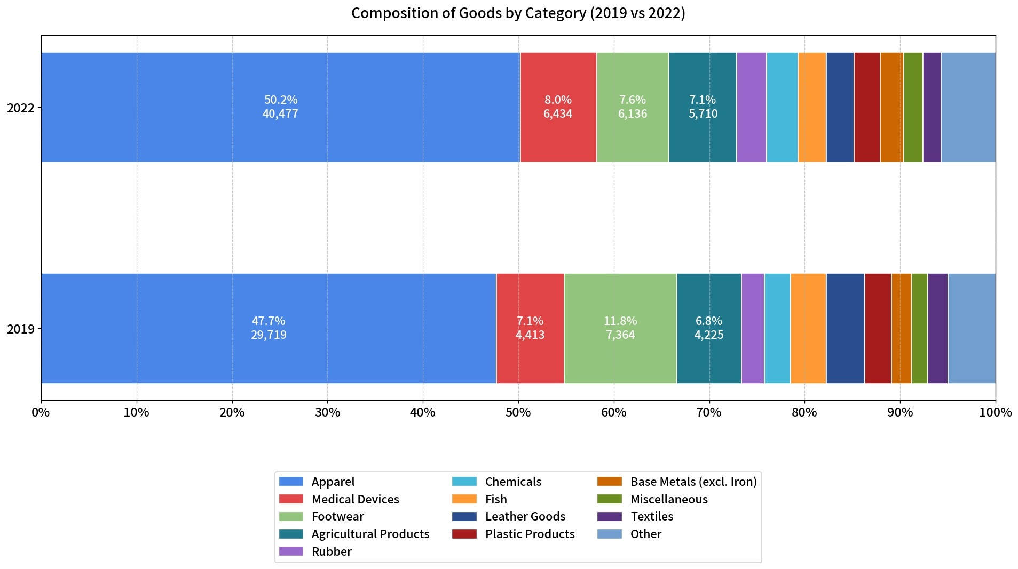
Evaluation of the Implementation of the EU Critical Raw Materials Strategy
Strategic Raw Materials List (16 Items)
The EU's critical raw materials strategy has shown multi-dimensional, dynamic development. In terms of strategic changes, the release of the Critical Raw Materials Act (CRMA) has enhanced supply chain resilience. This includes developing a strategic raw materials list with more detailed classifications, proposing strategic projects with implementation guarantees, regularly updating the critical raw materials list, setting internal supply targets, and establishing a new Critical Raw Materials Board to improve management.
The key priorities of implementation have been to finalize the legislative framework of the CRMA to secure the supply of minerals such as lithium, while actively building international partnerships.
In terms of effectiveness, exports of raw materials from Generalized Scheme of Preferences (GSP) beneficiary countries to the EU have increased significantly. Although dependence on external sources for certain raw materials has decreased, it remains high.
Regarding progress, the EU continues to assess technological risks in raw material identification. Through the CRMA, it is safeguarding supply across multiple dimensions. It is also improving project pipelines and regulatory frameworks to promote innovation and sustainability, including supporting innovative projects and updating rules for use and recycling.
Bismuth, Boron (metallurgical grade), Cobalt, Copper, Gallium, Germanium, Lithium (battery grade), Magnesium metal, Manganese (battery grade), Natural graphite (battery grade), Nickel (battery grade), Platinum group metals, Rare earth elements for magnets (Nd, Pr, Tb, Dy, Gd, Sm and Ce), Silicon metal, Titanium metal, Tungsten
Exports of GSP Beneficiary Countries (2019, 2022)
(Unit: %, Million Euros)

Slide 16
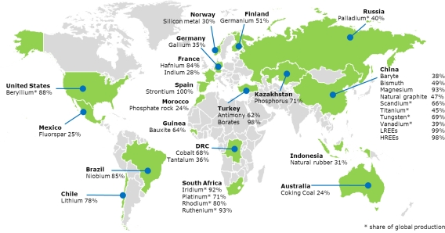
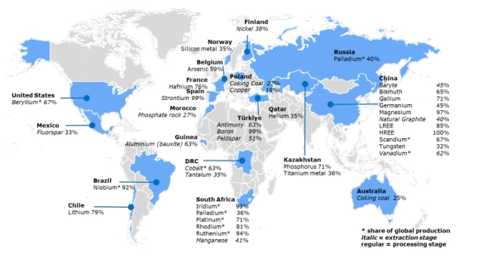
Evaluation of the Implementation of the EU Critical Raw Materials Strategy
Main Supplier Countries of EU Critical Raw Materials in 2020
Main Supplier Countries of EU Critical Raw Materials in 2023
Although the external dependence for some raw materials has decreased, it remains high. Compared with 2020, the EU’s imports of light rare earth from China fell from 99% to 85% in 2023, and natural graphite from 47% to 40%. However, China remains the EU’s largest supplier of critical raw materials, providing nearly all of the EU’s magnesium and heavy rare earth.

Slide 17
3. Global Trends in Rare Earth Development

Slide 18
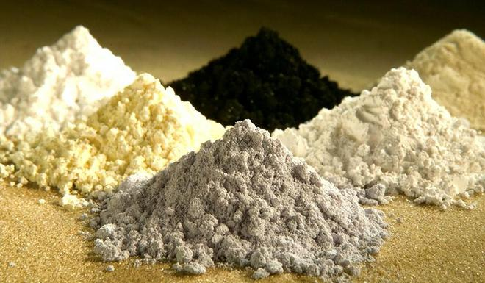
In terms of global rare earth consumption demand trends, global consumption of rare earth oxides reached approximately 402,000 tonnes in 2025, with China, the United States, and Japan as the major consumers. China accounted for about 90% of total consumption, while Japan and the United States together accounted for approximately 8%, with other countries and regions making up the remaining 2%. China possesses the world's only complete rare earth industrial system, giving it a significant advantage. Meanwhile, the global rare earth supply chain is accelerating its diversification. The United States, taking the lead in introducing policies, is increasing investment in its domestic rare earth industry and rallying multiple countries to form resource circles, such as the Energy Resource Governance Initiative and the Minerals Security Partnership, in an attempt to reduce dependence on China and challenge China's dominant position in the supply of critical minerals.

Slide 19
Overall Guidelines for China's Rare Earth Development During the 15th Five-Year Plan Period
Overall Guidelines: Guided by Xi Jinping Thought on Socialism with Chinese Characteristics for a New Era, we will implement the guiding principles of relevant Party meetings and General Secretary Xi Jinping's important instructions, and apply the new development philosophy. Through measures such as consolidating the resource foundation and optimizing mining rights, we will foster a new pattern in resource exploration, development, and protection. This will transform resource advantages into industrial and strategic strengths, driving high-quality development of the rare earth industry during the 15th Five-Year Plan period.
Basic Principles: intensify exploration and development and optimize the spatial layout; promote green innovation, coordinate resource development and environmental protection, and improve resource utilization efficiency as well as the level of technology and equipment; strengthen policy coordination, implement laws and regulations and deepen reform; and promote win-win cooperation, give full play to our strengths, utilize resources from both domestic and international markets, and establish a diversified security system.
Strategic Objectives: Our strategic objectives by 2030 are to enhance China's global discourse power in medium and heavy rare earths, with the output of medium and heavy rare earths (REO) reaching 25,000 to 30,000 metric tons, and boost the supply capacity of light rare earths, with the output of light rare earths (REO) hitting 450,000 to 500,000 metric tons. Specifically, 100,000 metric tons of rare earth resources will come from recycling and reuse, while 350,000 to 400,000 metric tons will be produced from raw ore. Major breakthroughs will be made in key technologies and equipment for resource exploration and development, and advanced and applicable technologies will be fully popularized and applied.

Slide 20
Overall Layout of the Rare Earth Industry During the 15th Five-Year Plan Period
Key Rare Earth Resource Survey Areas During the 15th Five-Year Plan Period
Key Rare Earth Resource Survey Areas During the 15th Five-Year Plan Period
No. | Province (Region, Municipality) | Volume | Name
1 | Inner Mongolia | 1 | ......
2 | Zhejiang | 1 | ......
3 | Fujian | 4 | ......
4 |  |  | ......
5 |  |  | ......
6 |  |  | ......
7 | Jiangxi | 5 | ......
8 |  |  | ......
9 |  |  | ......
10 |  |  | ......
11 |  |  | ......
12 | Shandong | 1 | ......
13 | Hubei | 1 | ......
14 | Guangxi | 3 | ......
15 |  |  | ......
16 |  |  | ......
17 | Yunnan | 1 | ......
No. | Province (Region, Municipality) | Volume | Name
1 | Inner Mongolia | 1 | ......
2 | Zhejiang | 1 | ......
3 | Jiangxi | 1 | ......
4 | Hubei | 1 | ......
5 | Guangdong | 1 | ......
6 | Guangxi | 2 | ......
7 |  |  | ......
8 | Yunnan | 2 | ......
9 |  |  | ......
10 | Gansu | 1 | ......
11 | Qinghai | 1 | ......
Mineral Geological Survey
China is rich in rare earth resources, mainly distributed across several provinces and regions in South China and western Sichuan. It is recommended that during the 15th Five-Year Plan period, the Group establish national planned mining areas in eight provincial regions including Hubei, and incorporate 11 key survey areas and 17 key exploration areas into the national planned mining zone framework.

Slide 21
Overall Layout of the Rare Earth Industry During the 15th Five-Year Plan Period
Key Planned Mining Areas
Key Planned Rare Earth Resource Zones During the 15th Five-Year Plan Period
No. | Name | Administrative Location | Exploration Level | Estimated Additional Resources (10,000 t REO)
1 | XXX Rare Earth Mine, Baotou, Inner Mongolia | Baotou | Prospecting | ...
2 | XXX Rare Earth Mine, Longnan, Jiangxi | Longnan | Reconnaissance | ...
3 | XXX Rare Earth Mine, Longnan, Jiangxi | Longnan | Reconnaissance | ...
4 | XXX Rare Earth Mine, Dingnan, Jiangxi | Dingnan | Reconnaissance | ...
5 | XXX Ore Section, Anyuan, Jiangxi | Anyuan | Prospecting | ...
6 | XXX Rare Earth Mine, Shaoguan, Guangdong | Shaoguan | Reconnaissance | ...
7 | XXX Rare Earth Mine, Pingnan, Guangxi Zhuang Autonomous Region | Pingnan | Detailed Exploration | ...
8 | XXX Rare Earth Mine, Pingnan, Guangxi Zhuang Autonomous Region | Pingnan | Prospecting | ...
9 | XXX Rare Earth Mine, Liangshan Prefecture, Sichuan | Liangshan Prefecture | Prospecting | ...
During the 14th Five-Year Plan period, a series of geological surveys led to the discovery of XXX million tonnes of new rare earth oxide resources. Among these, significant increases in rare earth resources were identified in the Liangshan Prefecture of Sichuan Province and the Anyuan County of Jiangxi Province.

Slide 22
Overall Layout of the Rare Earth Industry During the 15th Five-Year Plan Period
Major Green & Technological Upgrading Projects for Rare Earth Resource Development and Utilization
Green and Efficient Mining Technologies | ◆Research on leaching technology and engineering for ion-adsorption rare earth deposits under complex geological conditions ◆Research on high-efficiency recovery and recycling technology for leachate, along with supporting equipment ◆Research on mine wastewater treatment and high-efficiency recovery of trace rare earths ◆Development of eco-friendly leaching models and ecological restoration engineering techniques ◆Application and promotion of green, efficient integrated leaching-extraction technology for ion-adsorption rare earth ores
Green and Efficient Beneficiation & Metallurgical Processes and Equipment | ◆New beneficiation reagents, green and efficient beneficiation processes, and equipment ◆Priority separation technology for high-abundance rare earth elements ◆Research, development, and application of novel extraction reagents ◆High‑efficiency, clean extraction technology for complex, low‑grade rare earth resources ◆Promotion and application of the magnesium bicarbonate method for separation and purification
Comprehensive Resource Utilization | ◆Comprehensive recovery technologies for associated valuable elements such as niobium, fluorine, thorium, molybdenum, and uranium ◆Green and high-efficiency recovery and utilization technologies for secondary rare earth resources ◆Source reduction and harmless treatment technologies for radioactive rare earth waste residues
Key Technological Breakthroughs
During the 15th Five-Year Plan period, China should intensify efforts to achieve technological breakthroughs in rare earths, driving the industry toward high-end, green, and intelligent development, thereby enhancing its global competitiveness.
Major Digital Transformation and Upgrading Projects for Rare Earth Mines
Digital Mine Construction | ◆Basic database and data sharing platform for rare earth mine resource extraction and beneficiation ◆Intelligent production control system for rare earth mines ◆Digital management system for production monitoring and scheduling, and environmental monitoring system for rare earth mines
Smart Factory Construction for Smelting and Separation | ◆Real-time monitoring system for smelting and separation enterprises ◆Dynamic control and management system for smelting and separation enterprises

Slide 23
Overall Layout of the Rare Earth Industry During the 15th Five-Year Plan Period
Key Technological Breakthroughs
Major Projects for High-End Development of Rare Earth Functional Materials
Basic Theoretical Research | ◆Reveal the intrinsic characteristics of rare earth elements; develop the theory of 4f5d electron crystal fields ◆Study the microscopic mechanisms of rare earth 4f5d electrons in various functional materials
High-Performance Functional Materials | ◆Major technological breakthroughs in production processes such as large-crystal diffusion, dual-main-phase preparation, and injection molding for magnetic materials, as well as key equipment including sintering furnaces, deformation furnaces, rapid solidification furnaces, and rapid quenching furnaces ◆Development and application of hot‑pressed and bonded rare earth permanent magnets with high remanence and high stability, as well as samarium-cobalt magnets with high operating temperature and high temperature stability ◆Research and development of high-luminance, low-lumen-depreciation, high-stability nitride/oxide and fluoride emerging luminescent materials, along with high-efficiency preparation technologies and automated equipment for high-performance phosphors ◆Development and application of high-power-density, full-spectrum healthy lighting, and high-color-gamut display luminescent materials and devices ◆Low-cost preparation of high-purity anhydrous raw materials for rare earth halide scintillation crystals, key technologies for large-crystal growth, processing, and packaging, as well as research on intelligent crystal growth furnaces ◆Development of rare earth scintillation crystals with high energy and high time resolution, and high-power, high-energy rare earth laser crystals ◆Research and development of rapid solidification melting and casting processes, and preparation technologies for high-capacity, long-life hydrogen storage materials ◆Development of high-performance rare earth nickel-metal hydride batteries with wide temperature range, high specific capacity, and low self-discharge, along with new high-capacity rare earth hydrogen storage materials and devices ◆Key preparation technologies for high-thermal-stability ceria-zirconia oxygen storage materials, high‑dispersion noble metal technologies, and high-precision, high-stability catalyst coating manufacturing processes and systems ◆Research and development of deep-processing preparation technologies and equipment for ultra-high purity rare earth metals and sputtering targets
During the 15th Five-Year Plan period, China should intensify efforts to achieve technological breakthroughs in rare earths, driving the industry toward high-end, green, and intelligent development, thereby enhancing its global competitiveness.

Slide 24
Overall Layout of the Rare Earth Industry During the 15th Five-Year Plan Period
Promoting the Domestic and International Dual Circulation of Rare Earth Resources
1. Strengthen foreign cooperation and enhance global deployment capabilities.
Leverage capital advantages based on the global distribution of light rare earth resources. Participate in rare earth exploration and development in countries such as Myanmar and Vietnam through equity acquisitions and other means, thereby reshaping the supply chain landscape. Capitalize on China’s rare earth technology and talent advantages to advance ion-adsorption rare earth international cooperation, contract mining operations, increase supply, prevent the outflow of talent and technology, and build a diversified supply chain.
2. Strengthen the security of domestic rare earth technology and processes, and intellectual property management to prevent technology outflows.
Enhance technology and process security through preliminary assessments, employee training, security monitoring, and core technology protection. Study foreign patent policies, file patent applications in a timely manner, protect trade secrets, and establish legal teams to strengthen IP management, safeguard technological advantages, and protect legitimate rights and interests.
3. Enhance responsibility awareness and uphold the international image.
Follow ESG trends by promoting the improvement of management, practices, and information disclosure across the entire industry chain, and strengthen communication with stakeholders. Reinforce industry self-discipline, advance the development of a credibility system, strictly control production capacity, avoid internal friction and disorderly competition, engage in international exchanges, and build an international rare earth resource community to maintain a positive international image.

Slide 25
Forecast of China’s Rare Earth Consumption Demand
Significant Achievements in Rare Earth Exploration in China
Rare Earth Resource Consumption Forecast
Rare Earth Consumption Forecast
China’s rare earth reserves have steadily increased, with major discoveries made in Liangshan Prefecture of Sichuan, Gannan of Jiangxi, and Shaoguan of Guangdong, leading to a substantial rise in newly identified resources.
By 2030, the demand for rare earth is expected to be driven by growth in new energy vehicles, wind power, and industrial motors. Emerging fields such as humanoid robots will also become new growth drivers.
China's rare earth resource consumption is projected to reach 480,000–530,000 tonnes by 2030, and 600,000–650,000 tonnes by 2035, with the focus remaining on light rare earths.
High- and Low-Scenario Forecasts for China’s Rare Earth Resource Consumption (2030 & 2035)
Rare Earth Consumption Growth Analysis by Sector
Sector | Trend Analysis
New Energy Vehicles (NEVs) | Adamas Intelligence forecast that demand for rare earths in EVs will grow by 350% between 2018 and 2025, with a further 127% increase expected between 2025 and 2030. As the global penetration rate of NEVs continues to rise each year, rapid demand growth in this sector is one of the core drivers of rare earth consumption growth.
Wind Power | Wind power is developing toward larger installed capacity and further offshore deployment, with significant potential in offshore wind. The application scope of rare earth permanent magnet generators is expanding, driving sustained and steady demand growth.
Industrial Motors | China is promoting industrial energy-saving retrofits and encouraging the use of high-efficiency motors. In 2023, the production of high-efficiency motors grew steadily YOY. Driven by policy support and corporate demand, the demand for rare earths in industrial motors is increasing.
Emerging Sectors | These sectors are in their early but rapidly developing stages, with strong demand for high-performance magnetic materials. Although their current share is small, they are expected to demonstrate strong growth momentum by 2030.
Year | Projected Consumption (10,000 tonnes REO)
2025 | Total | Low Scenario | High Scenario
 |  | 28 | 28
 | Light Rare Earth | 26 | 26
 | Medium and Heavy Rare Earth | 2 | 2
2030 | Total | 48 | 53
 | Light Rare Earth | 45.5 | 50
 | Medium and Heavy Rare Earth | 2.5 | 3
2035 | Total | 60 | 65
 | Light Rare Earth | 55 | 59
 | Medium and Heavy Rare Earth | 5 | 6

Slide 26
Total Mining Quota for the 15th Five-Year Plan Period
China's 2024 Rare Earth Total Control Quotas
In 2024, the total rare earth mining and smelting & separation quotas for the first two batches were 270,000 tonnes and 254,000 tonnes, respectively.
No. | Rare Earth Group | Mining Product (in REO equivalent, tonnes)
1 | China Rare Earth Group | Rock Type (Light) | Ion-Adsorption (Mainly Medium-Heavy) | Rock Type (Light) | Ion-Adsorption (Mainly Medium-Heavy)
 |  | First Batch |  | Second Batch
 |  | 30,280 | 10,140 | 31,920 | 9,010
2 | Northern Rare Earth | 94,580 |  | 94,070
Subtotal |  | 135,000 |  | 135,000
Total |  | 270,000
2024 Rare Earth Mining Quota
Forecast of Rare Earth Mining Control Quotas for the 15th Five-Year Plan Period
By 2030 and 2035, China's rare earth recycling production is expected to reach 100,000 tonnes and 250,000 tonnes, respectively, supporting the sustainable development of the rare earth industry.
Forecast for China's Rare Earth Production Control Quotas (2030 & 2035)
Year | Projected Production (10,000 tonnes REO)
2025 | Total | Low Scenario | High Scenario
 |  | 28 | 28
 | Light Rare Earth | 26 | 26
 | Medium and Heavy Rare Earth | 2 | 2
2030 | Total | 38 | 43
 | Light Rare Earth | 35.5 | 40
 | Medium and Heavy Rare Earth | 2.5 | 3
2035 | Total | 35 | 40
 | Light Rare Earth | 32.5 | 36.5
 | Medium and Heavy Rare Earth | 2.5 | 3.5

Slide 27
4. Policy Proposals for the High-Quality Development of China’s Rare Earth Industry During the 15th Five-Year Plan Period

Slide 28
First, strengthen the regulation of medium and heavy rare earth while relaxing controls over light rare earth. The current production and smelting & separation quotas for rare earths do not align with market demand, affecting industry management. It is recommended to maintain mandatory planning and control for medium and heavy rare earths to ensure the rational utilization of resources, while abolishing mandatory planning for light rare earths and adopting guidance‑based or market‑oriented management. Through annual hearings, quota adjustments should be made scientifically to improve their alignment with the market and stimulate market vitality.
Second, optimize block auctions and expand strategic resource advantages. China has prominent advantages in the rare earth sector. To consolidate these advantages, support should be given to the development of compliant rare earth mineral resources. Relevant authorities should process exploration and mining licenses in a timely manner, focus on resolving the issues of ion-adsorption rare earth mines where permits exist without actual mining or mining occurs without permits, clear key bottlenecks in resource development, and enhance China’s competitive edge and international market position in the global rare earth industry.

Slide 29
Third, comprehensively utilize fiscal and tax policies to strengthen the development and application of key technologies. To promote the development of the rare earth industry, it is necessary to implement fee and tax reductions. Adjust the resource tax on ion-adsorption and rock-type rare earth mines based on element categories: lower the tax rate for light rare earths and raise it for medium and heavy rare earths. Increase investment in green rare earth development and digital mine construction, promote the high-end application of functional materials, and conduct research and development on surplus rare earth elements to improve resource utilization efficiency.
Fourth, strictly enforce access and technical barriers to promote the healthy development of the rare earth industry. To ensure the healthy development of the rare earth industry, supervision must be strengthened in areas such as environmental protection, safety, tax contributions, rights protection, and social responsibility. Implement a negative list system for market access for X-T enterprises, regulate market order, and support enterprises in participating in competition. Encourage the use of overseas compliant rare earth resources, leveraging both domestic and international markets and resources to support the sound development of the industry.

Slide 30
企业简介
Thanks!

